Slide 1
Team 5 Expedia Hotel Recommendations Ruchira R. Patil Ziqing Zhou

Slide 2
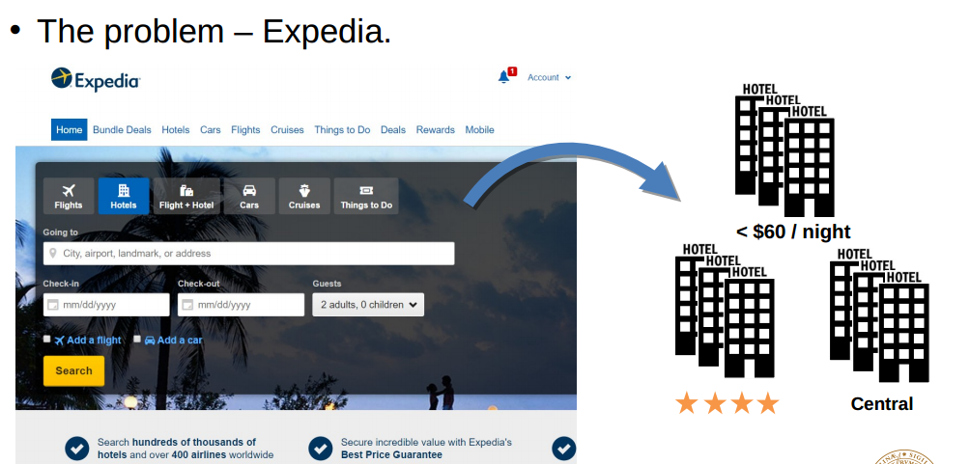
Use cases to be satisfied for hypothetical customers;
1)Displaying Hotel Recommendations for current user
2)Displaying Recommendations based on different user inputs.
3)BI and descriptive Analysis Dashboard for Analysts
4)Predicting which hotels will customer choose for Analysts

Slide 3
Methodology (how/what do you propose to do);
Recommendation (MapReduce)
Prediction (Machine Learning : Decision Trees or Logistic Regression)
Descriptive Analysis and BI
Creating web dashboards using Play Framework

Slide 4
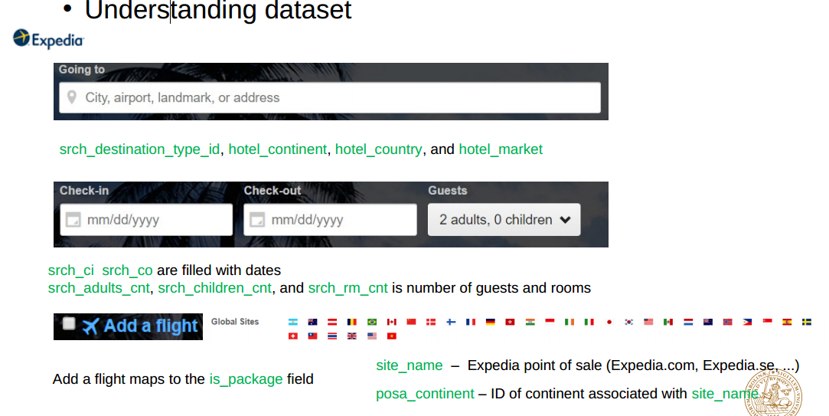
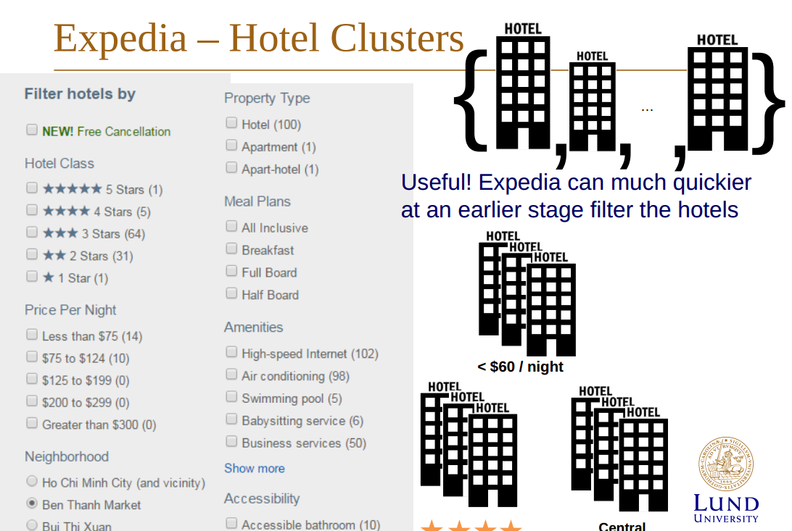
Data sources, enumerating the magnitude of the data that you will process;
Expedia – dataset(Kaggle) • 24 column in training(4.09GB) • 22 column in testing (no is_booking, no hotel_cluster)(424MB) • Most of the columns are integers or floats • Output hotel cluster ID integer range from 1-99

Slide 5
Milestones/sprints (approximately one week to ten days between each);
Sprint 1: Data cleaning, Creating clusters and Spark development environment set up , finalizing which machine leaning algorithm to use
Sprint 2: Implementing MapReduce with Spark, Implementing Machine learning with MLLIb.
Sprint 3: Building Web Dashboards using Play Framework

Slide 6
What will you program in Scala and where will your code repository be?
Data Processing in Spark (MaprReduce,Machine Learning)
Scala playframework to create BI dashboards
https://github.com/Ruchi2729/Scala-Final-Project

Slide 7
Acceptance criteria (how will I know that you have achieved what you set out to do?);
Consuming apache spark MLLib for machine learning and achieving at least 65% of accuracy
Implementing MapReduce for recommendations and for descriptive analysis.
Creating Interactive web Dashboard using Play Framework(IF TIME PERMITS)

Slide 8
Goals of the project (what do you expect to achieve and accomplish).
Our goal of this project is to predict the booking outcome (hotel cluster) for a user event, based on their search and other attributes associated with that user event.
Prediction and recommendation using Machine learning and MapReduce consuming Spark APIS

